Slide 1
WE KNOW YOUR AGE

Slide 2
Hook
Are you passionate about animal?
Age prediction based on various survey questions

Slide 3
Interesting Non-Regression Facts
Histogram of Age
For the survey questions that were rated 1-5, we treated it as quantitative variable.

Slide 4








Data Explanation
19
12
10
57
Total Participants
1010
people
Survey Questions
150
items
3
7
10
32
Notes:
1. Participants (1010 rows) :
2. Survey Questions(150 items columns):
Music preferences (19 items)
Movie preferences (12 items)
Hobbies & interests (32 items)
Phobias (10 items)
Health habits (3 items)
Personality traits, views on life, & opinions (57 items)
Spending habits (7 items)
Demographics (10 items)

Slide 5
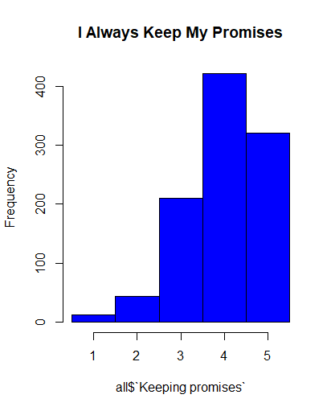
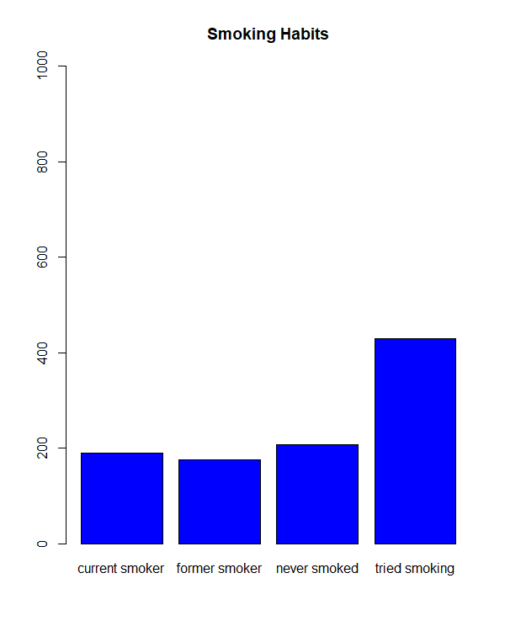
Quantitative & Categorical Variables
Strongly Disagree 1-2-3-4-5 Strong Agree
Categorical
Notes:
Survey Questions(139):
I always keep my promises.:
Strongly disagree 1-2-3-4-5 Strongly agree (integer)
Categorical Questions(11):
Smoking Habits
Never smoked - Tried smoking - Former smoker - Current smoker (categorical)

Slide 6
Variable Definition
Y: Age(in demographics category)
Xs: all other 149 survey questions
Music preferences, Movie preferences, Hobbies, etc.
Intuition:
Identify correlation between Age and all other survey questions
Build regression models to predict age

Slide 7

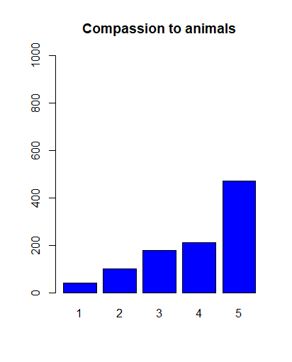
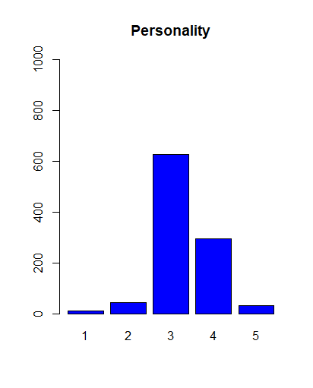
Industry Knowledge Emulation Model (IKEM)
More than 60%
VS.
Less than 20%
Notes:
The interpretation of the distribution of any particular question is:
Large percentage of responses = “3” means overall weak opinion of the question
Only include survey questions that have less than 20% of the responders choose “3”.
A survey question’s distribution with higher variance would be indicative of clusters of responders of similar age.
Use these variables, along with all qualitative and quantitative survey questions to predict Age via regression.

Slide 8
IKEM Justification
Motivation: Reduce number of low quality variables
Result: Variable count reduced from 149 to 44
Note: Variables maintained after filter only applies in context of the whole survey. Cannot compare a survey with only these questions to the full survey.
Example: You may have answered “3” for Personality because the previous question on the survey asked if you consider yourself a judgmental person. Your answer for personality is reasonably affected by the previous question.

Slide 9
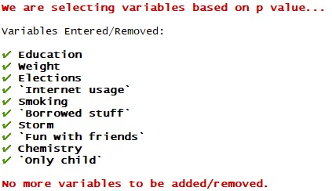
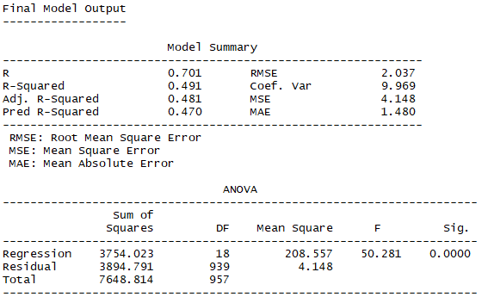
IKEM – Stepwise on Filtered Data
R² = 0.491, Adj. R² = 0.481, Pred R² = 0.470

Slide 10
Josh’s Methodology
Filter variables if less than 200 survey takers answered “3”
Variables reduced from 149 to 50.
Stepwise Algorithm to detect significant variables
Variables reduced from 50 to 10.
Brute Force Algorithm to discover optimal solutions
Prediction: 9 Variable Model: R²_{jack} = 0.4704
Descriptive: 10 Variable Model: R²_{adjusted} = 0.4810
AIC: 10 Variable Model: AIC = 4102.3267

Slide 11
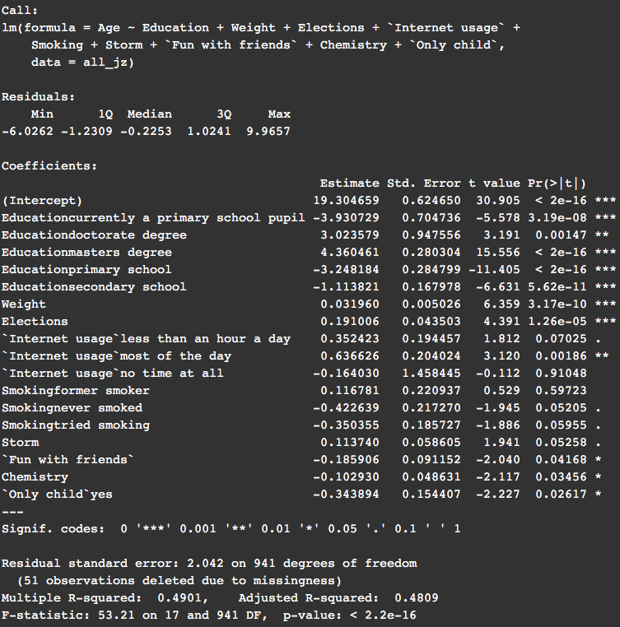
Interpretations
Note:
Unless eloquated below, all beta coefficients are logical by common sense.
Education seems to be very significant in determining a person’s age. This is as expected.
The coefficient for weight suggests that someone 1 year older will weigh 1/0.032 = 31.25 pounds more, which seems a little bit high.
A phobia of storms (Storm) increases with age. On the one hand, children may be scared of a storm’s ferocity, but storms could cause property damage for people who are older.
Having fun with friends is more important for younger people. A moment for the loss of innocence.

Slide 12
Stepwise V.S. Brute Force
Stepwise: (38*39)/2= 741 Seconds or 12.35 Mins
(My Mac → under 3 mins)
Brute Force: 2¹⁵⁰ = 7.1362385e+44
Take forever to finish

Slide 13
Stepwise Selection(Level 1,2)
Level 1: Included all variables, linear regression model
R²= 0.6478 R²_{a}=0.544 PRESS =3152.945 R²_{jack} = 0.3727
(Base Model, improve upon)
Level 2: Stepwise selection(38 variables selected)
R²= 0.585 R²_{a}=0.561 PRESS =3139.057 R²_{jack} = 0.4604

Slide 14
Stepwise Selection(Level 3)
Level 3: Excluded insignificant & unrelated variables(8)
& Combined Terms(2)
R²= 0.598 R²_{a}=0.5765 PRESS =3063.743 R²_{jack} = 0.5507
Terms deleted for Level 3:
Branded clothing high p value →0.086
Cheating in school high p value →0.144
Is only child → irrelevant
block of flat VS bungalow → irrelevant
Term modified for Level 3
internet usage & smoking

Slide 15
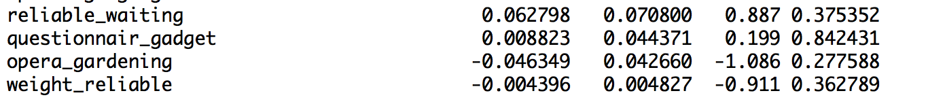
Stepwise Selection(Level 4)
Level 4: Add Interaction Terms
R²=0.599 R²_{a}=0.5760 PRESS =3085.696 R²_{jack} = 0.4525
reliable_waiting=reliable * waiting
questionnair_gadget=questionnair*gadgets
opera_gardening=opera*gardening
weight_reliable=weight * reliable

Slide 16
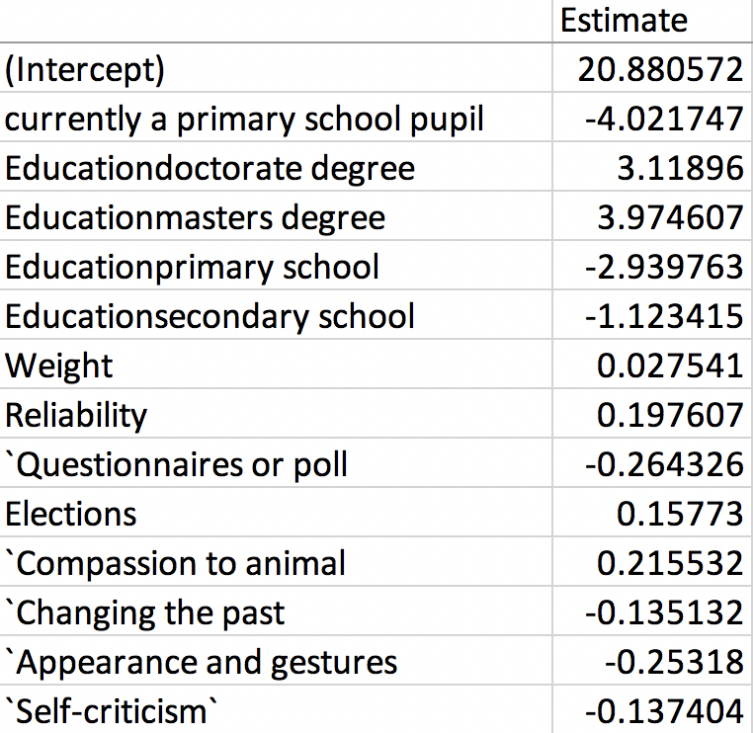
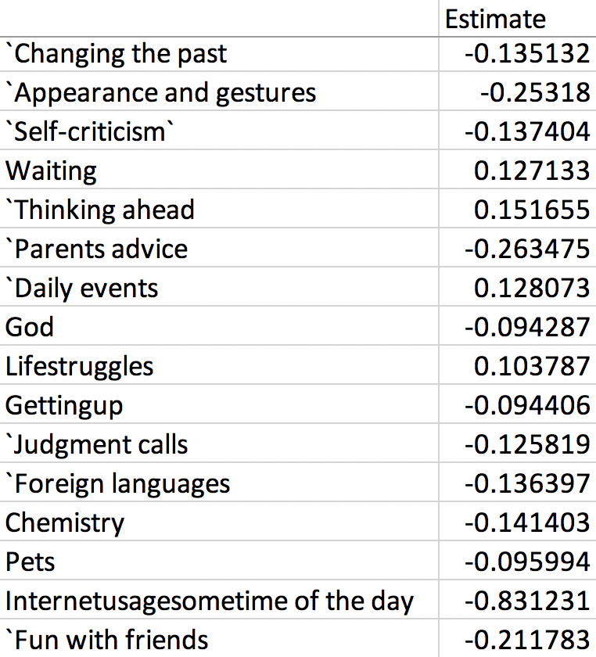
Interpretations

Slide 17
Final Model: Level 3
Level 1: R²= 0.6478 R²_{a}=0.544 PRESS =3152.945 R²_{jack} = 0.3727
Level 2: R²= 0.585 R²_{a}=0.561 PRESS =3139.057 R²_{jack} = 0.4604
Level 3: R²= 0.598 R²_{a}=0.5765 PRESS =3063.743 R²_{jack} = 0.5507
Level 4: R²=0.599 R²_{a}=0.5760 PRESS =3085.696 R²_{jack} = 0.4525

Slide 18
Conclusions and Future Work
In 2013, students of the Statistics class at FSEV (Faculty of Social and Economic Sciences, Comenius University in Bratislava) UK were asked to invite their friends to participate in this survey
All participants were Slovakian nationality, aged between 15-30.

Slide 19
Acknowledgement
Data from Kaggle.com
The data contains missing values.
All participants were of Slovakian nationality.
Age is between 15-30.

